Slide 1
Gene Tree Improvement Tool
Team: May 15-10
Advisor: Ruchi Chaudhary
Client: Prof. J. Gordon Burleigh
Team Members:
Ben Streit - Team Leader
Paul Leichty - Communication Leader
Cole Poffenberger - Key Concept Holder
Ian Ray - Webmaster

Slide 2
What is gene tree improvement?
Map from evolutionary trees to optimal gene tree
Multiple ways to achieve this result.
Mathematical
Biological
Notes:
phylogenetic - relationships among groups of organisms

Slide 3
Problem Statement
Adapting TreeFix to better help our clients needs
Using a different cost method
Integrating MulRF
Accepting non-binary species trees as an input
Currently throws an error
Notes:
What is a gene tree improvement tool?
TreeFix - phylogenetic tool for creating the most optimal gene tree from a species tree
Dup-Loss - Uses biological cost
MulRF - uses mathematical cost

Slide 4
Purpose
Dup-Loss Cost: Biological Computation
Not a final solution for all kinds of phylogenetic analyses
Robinson-Foulds Cost: Purely Mathematical Computation
Based on mathematical properties of gene/species trees.
May or may not model analyses with greater accuracy

Slide 5
Feasibility
Code base and Language we’ve never worked with
Held multiple Coding Jams to address the need for familiarizing ourselves with Python and TreeFix
Subject we’ve never worked with
Read computation biology research papers pertaining to relevant material

Slide 6
Conceptual Sketch
TreeFix (MIT base release)
MulRF TreeFix
TreeFix
TreeFix
RAxML Probability Module
RAxML Probability Module
Dup-Loss Cost Module
MulRF Cost Module
Dup-Loss Cost Module
Notes:
(Flow through treefix, User input into treefix and output)

Slide 7
Functional Requirements
Can calculate multiple types of cost algorithms
Allow user to select between Duploss and MulRF cost algorithms
Accept both binary and nonbinary trees
A
B
C
D
E
A
B
C
D
E
binary tree
non binary tree

Slide 8
Non-Functional Requirements
Can easily be extended to include new reconciliation cost algorithms (modularized, well documented)
Easily accessible and compilable
Easily accessible via a public github repository
Instructions on compilation/installation will be included
No modification to the interface (as requested by client)

Slide 9
Constraints and Considerations
RAxML was designed to only output binary gene trees
Client does not want a GUI created
Conforming to TreeFix’s modular structure
Notes:
being able to use duploss as well as new MulRF model
explain what RAxML is

Slide 10
Market Survey
Other gene tree improvement tools exist
Low computational resource consumption
Open-source MIT project extension
Tool itself not profitable
This project’s purpose is simply to enable new research
Notes:
TreeFix isn’t the only program available to calculate costs.
Cole

Slide 11
Potential Risks & Mitigations
Risk | Probability of occurrence | Impact on Project | Mitigation Strategy
May require extensive refactoring | 0.7 | High | Evaluate reusable code
May have to rewrite RAxML module to accept non-binary trees | 0.2 | Very High | Run test cases
Notes:
Cole

Slide 12
Resource/Cost Estimate
Resources
Dr. Gordon Burleigh, University of Florida
Ruchi Chaudhary, Iowa State University
Costs
No monetary hardware or software costs
Notes:
Prof. Burleigh - used to answer any questions and to provide test cases
Ruchi - Provided treefix and research documentation
Documents
Treefix
(No hardware required, treefix can run on basic computers)
Cole

Slide 13
Project Milestones & Schedule
First Semester
Create design and project plan
Implement RF module
Integrate RF module in TreeFix
Enable cost algorithm selection
Second Semester
Test RF algorithm
Allow non-binary species tree inputs
Test MulRF algorithm
Notes:
Cole

Slide 14
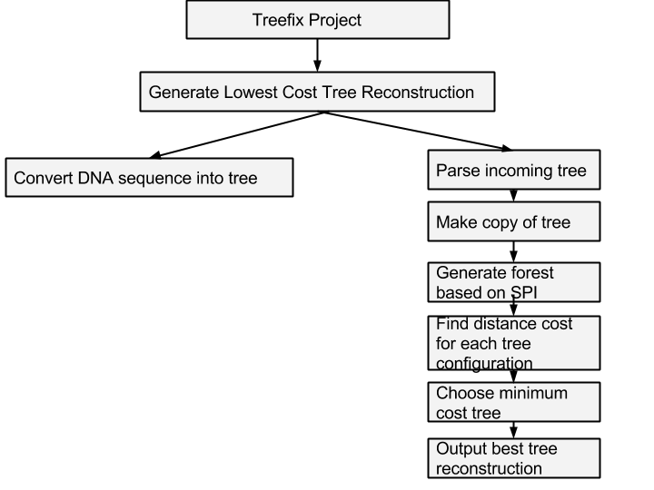
Functional Decomposition
Notes:
Ian

Slide 15
Detailed Design
TreeFix
Abstract Probability Model
– …
DupLoss Cost Model
– ComputeCost
–ReconRoot
– OptimizeModel
Abstract Cost Model
– ComputeCost
– ReconRoot
– OptimizeModel
main computation
MulRF Cost Model
– ComputeCost
RF algorithm
– OptimizeModel
User Inputs
Utility Frameworks
Notes:
Explain what the cost model is.
Ian

Slide 16
RF Algorithm Visualization
Gene Tree
Cluster Set:
{ {a b}, {c d}, {a b c d} }
Species Tree
Cluster Set:
{ {a b c}, {b c}, {d e} }
A
B
C
D
E
A
B
C
D
E
RF distance of 6.
Notes:
Ian
Robinson–Foulds Distance Algorithm
dist ← 0
Use least common ancestor (LCA) tree operation in order to produce reconciliation dictionaries from gene to species tree.
for each entry (g_key, s_value) in the gene->species reconciliation dictionary:
if g_key is not s_value:
dist ← dist + 2
normalize and return dist

Slide 17
Technology Platform Used
Python (2.5.4 or greater)
C compiler (gcc)
SWIG (1.3.29 or greater)
Numpy (1.5.1 or greater)
Scipy (0.7.1 or greater)
Notes:
Ian
Throw notes for what each does:
swig -
Numpy -
scipy -

Slide 18
Test Plan
RF Cost Model Testing
White Box
Client provided test cases
Black Box
MulRF Cost Model Testing
White Box
Client provided test cases
Black Box
Notes:
Ian
RF cost model - Binary tree inputs
MulRF cost - non-binary trees

Slide 19
Current Project Status
Completed versions of:
Project Plan
Design Document
Basic implementation of RF cost model
Started creating code structure and tests
Research into non-binary trees compatibility

Slide 20
Prototype Implementations
Demo
Notes:
Cole

Slide 21
Task Responsibility
Ben Streit
Paul Leichty
Cole Poffenberger
Ian Ray
Notes:
What each person did

Slide 22
Plan For Next Semester
Test RF algorithm
Refactor TreeFix to allow non-binary species trees as input
Test MulRF algorithm with non-binary species trees
Notes:
Ian

Slide 23
Questions?

